Slide 1






Forecasting the Future

Slide 2

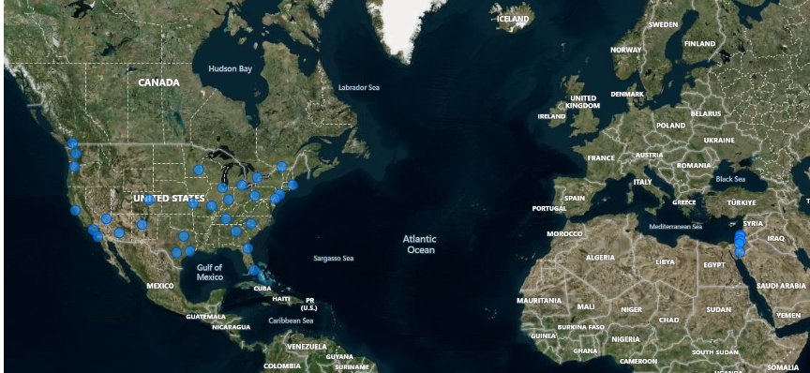
Can you create a geographical map in Power BI showing the distribution of cities in the dataset based on their latitude and longitude?
The map paints a clear picture, pinpointing cities with their latitude and longitude across the varied terrains of Canada, the bustling locales of the United States, and the distinctive settings of Israel. This visual representation captures the essence of each country’s geography, highlighting how latitude and longitude coordinate to chart the diverse urban landscape.

Slide 3
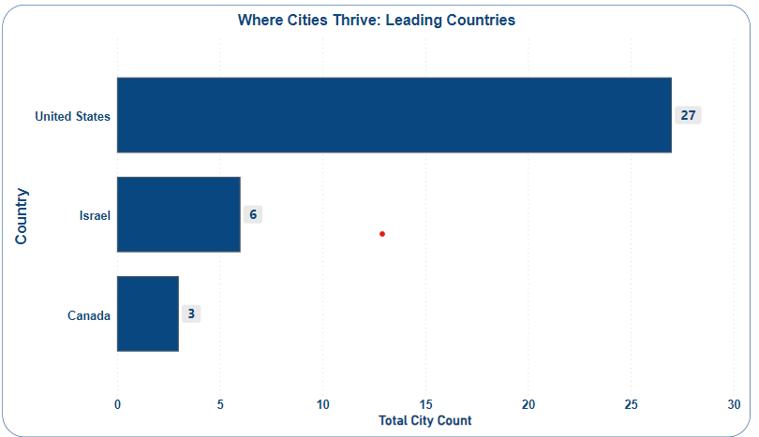

In Power BI, can you create a bar chart representing the top 10 countries with the highest number of cities in the dataset?
The chart illustrates that in the climate of urban development, the United States is leading with a significant number of cities, totaling 27, experiencing favorable conditions for growth. Israel follows with 6 cities enjoying a positive urban climate, while Canada has 3 cities that are also showing signs of thriving in their respective environments. This indicates that the United States has a much broader front of urban areas where the conditions are right for prosperity and expansion.

Slide 4
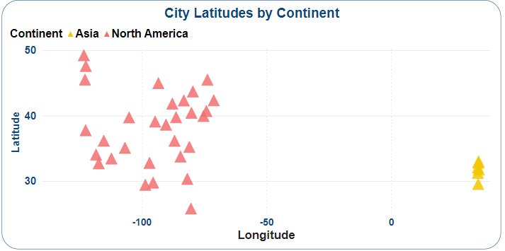

How does the distribution of cities in terms of latitude vary across different continents? Create a scatter plot in Power BI to illustrate this.
Asian cities are spread out across different latitudes, showing a diversity of climates across the continent. On the other hand, North American cities seem to be concentrated in one area, which could mean they share similar weather conditions across that region.

Slide 5

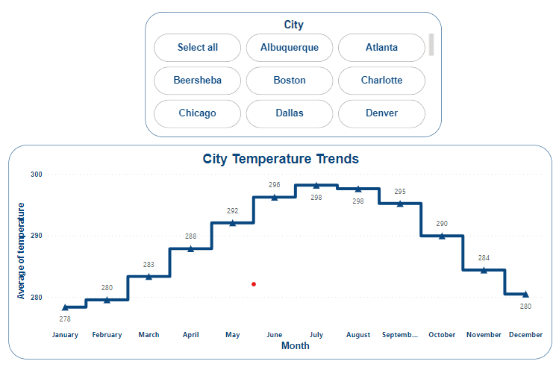
Create a line chart in Power BI to display the temperature trends over time for a selected city. Highlight extreme temperature events.
The line chart tracks the temperature trends over the year for a specific city. It shows a clear pattern of rising temperatures from January to July, peaking mid-year, before gradually declining towards December. Extreme temperature events can be identified by sharp peaks or drops on the chart, typically during the transition between seasons. The chart is designed to allow users to select a city and visualize its unique temperature trend, including any significant deviations from the average that might indicate heatwaves or cold snaps.

Slide 6

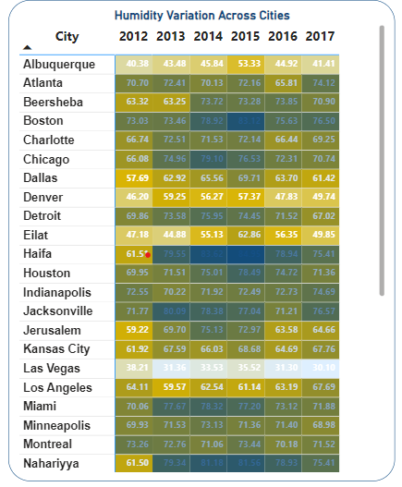
How does humidity vary across different cities? Generate a heatmap in Power BI to visualize this variation.
Humidity levels fluctuate across the cities, with Jacksonville generally experiencing high humidity, while Las Vegas reports much lower levels. Vancouver shows high humidity too, similar to Jacksonville. Over the years, these trends appear consistent with each city maintaining its general position on the humidity scale.

Slide 7

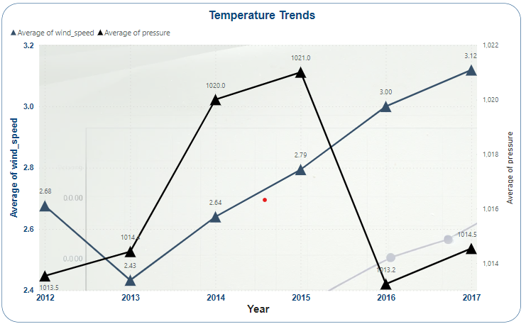
Can you create a time-series chart in Power BI showing the relationship between wind speed and air pressure for a specific city?
The chart indicates a fluctuating relationship between wind speed and air pressure over the years. Generally, as air pressure increases, wind speed also rises, suggesting a dynamic interplay between the two atmospheric conditions. The sharpest increase in both wind speed and pressure occurs between 2015 and 2017, indicating potentially more turbulent weather conditions in this period.

Slide 8

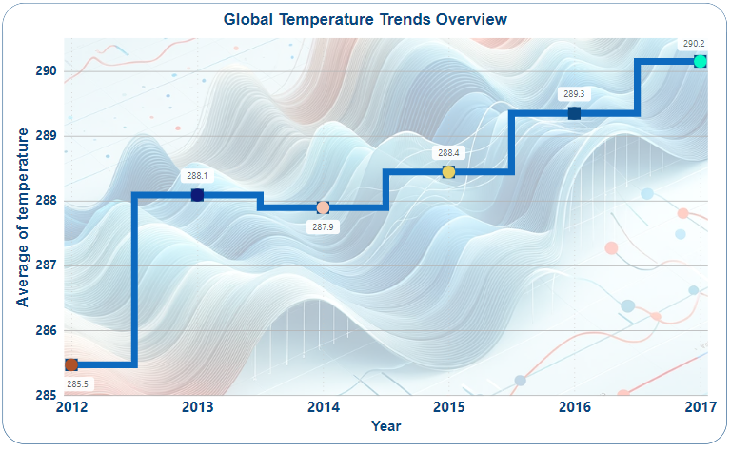
Create a time-series line chart in Power BI to show the overall temperature trends over the entire dataset.
The visual suggests a general upward trend in global temperatures from 2012 to 2017, with a notable increase particularly in the later years. This pattern could reflect a rising trend in average global temperatures over this time period.

Slide 9

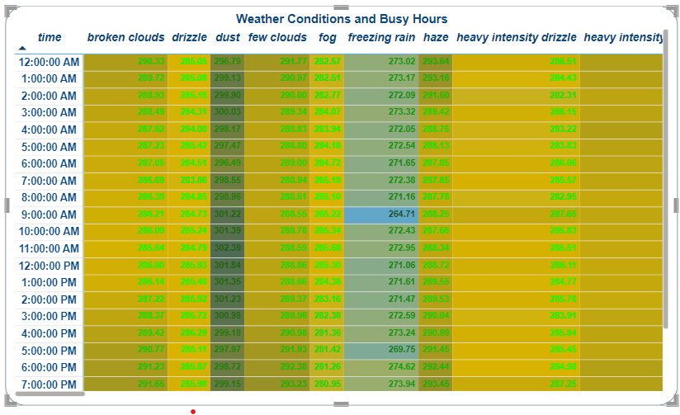
Can you create a heatmap in Power BI to visualize the busiest hours for specific weather conditions (e.g., "clear sky," "rainy")?
The heatmaps suggest certain times of day are consistently busier regardless of weather conditions. Weather impacts activity levels, with some conditions associated with more activity, others with less. This data could be useful for scheduling and planning around weather patterns.

Slide 10

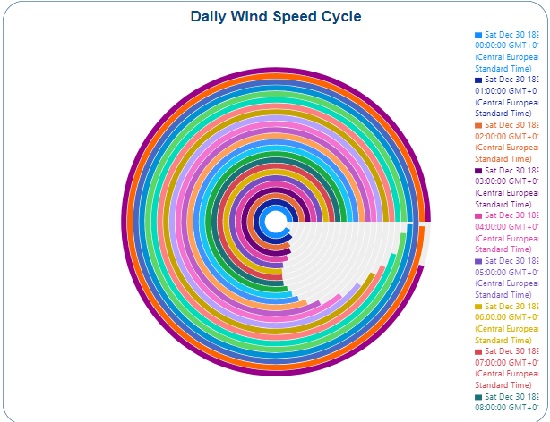
How does the wind speed change over the course of a day? Create a radial chart in Power BI to represent this.
Wind speed fluctuates significantly over the course of the day, with periods of higher wind speeds interspersed with calmer intervals. The visual suggests a cyclical pattern where certain times consistently experience higher or lower wind speeds. This information could inform activities affected by wind conditions, such as aviation, marine operations, or outdoor events.

Slide 11

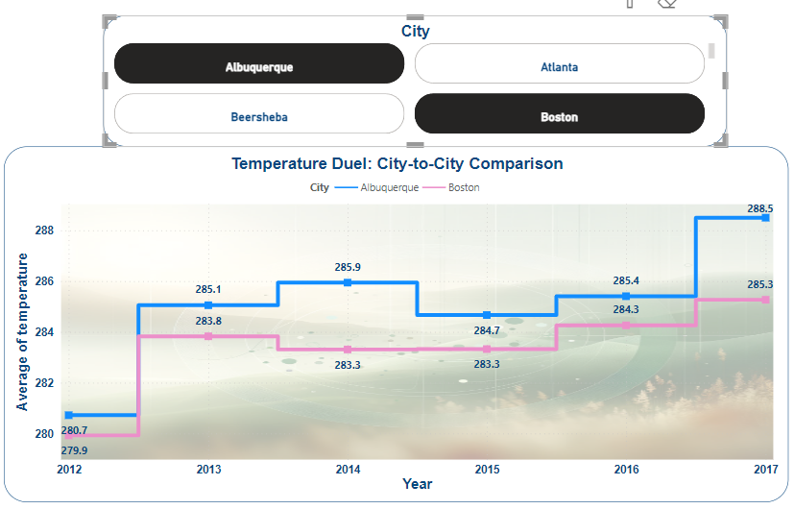
Create a Power BI chart comparing the temperature variations between two selected cities over a specific timeframe.
The chart compares average temperature variations between two selected cities over the years. The trend lines show how temperatures in one city generally stay above or below the other, with both cities experiencing some year-to-year changes. This visualization helps in understanding and comparing the climatic trends of the two cities

Slide 12
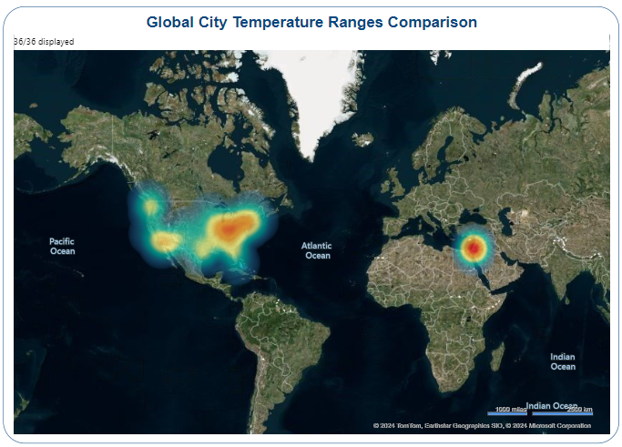

Can you build a heatmap in Power BI to show the temperature ranges for cities across different countries?
The heatmap indicates areas with significant temperature variations across different cities globally. The intensity of the colors represents the range of temperatures, with some regions showing more extreme differences than others. This visualization can help in identifying climate patterns and differences between cities worldwide.

Slide 13
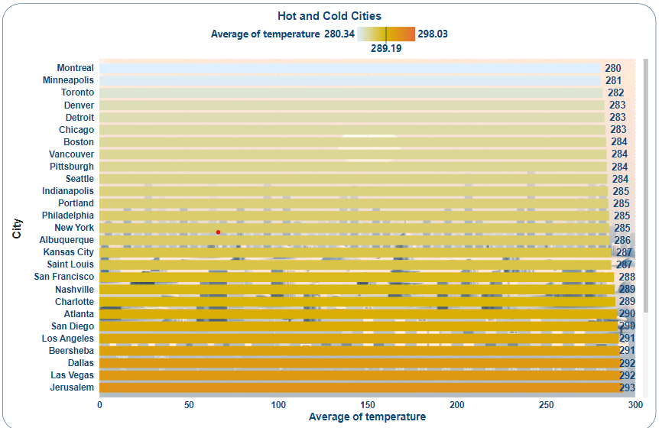

Create a bar chart in Power BI to highlight cities with the highest and lowest average temperatures in the dataset.
The bar charts provided showcase the average temperature for a selection of cities. The cities with the highest average temperatures stretch further to the right, indicating warmer climates, while those with shorter bars to the left have lower average temperatures. This visual comparison allows for a quick assessment of temperature ranges across different urban areas.

Slide 14
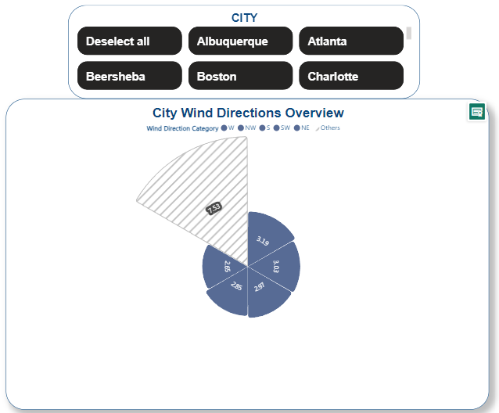

Create a wind rose chart in Power BI to visualize the prevailing wind directions for a selected city.
The wind rose chart for a selected city presents the prevailing wind directions. The chart's segments represent different wind directions, with the length of each segment indicating the frequency of winds coming from that direction. The conclusion drawn from this chart is that it helps identify which wind directions are most common in the selected city, which can be crucial for various planning purposes, from urban development to setting up wind farms.

Slide 15
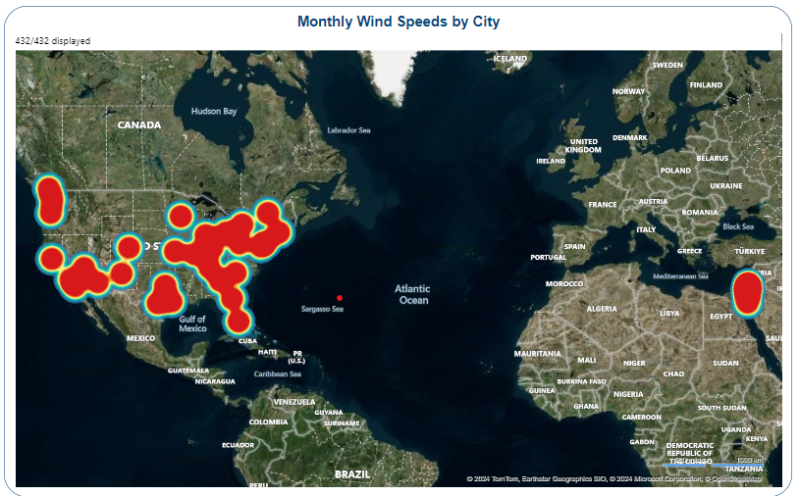

Can you generate a Power BI heatmap illustrating the average wind speeds across cities for different months of the year?
The heatmap illustrates the average wind speeds across cities, with color intensity indicating the wind speed levels. Red areas show where the highest wind speeds are prevalent, while blue areas indicate lower wind speeds. The visualization reveals geographic patterns in wind behavior and can be used to analyze seasonal wind changes, which is helpful for sectors like agriculture, energy, and transportation planning.

Slide 16

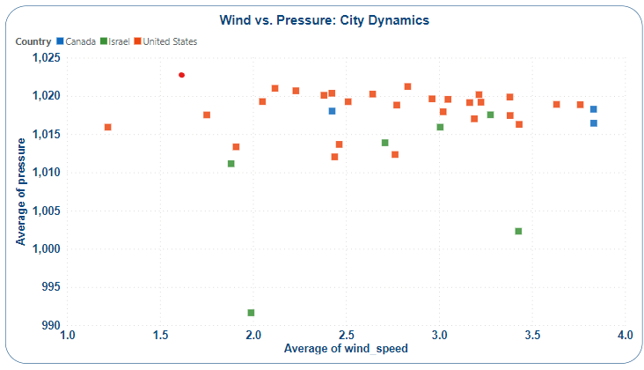
Create a Power BI scatter plot to show the relationship between wind speed and air pressure for a specific city.
The scatter plot comparing wind speed and air pressure across cities shows scattered data points, suggesting no strong correlation. This implies that in these cities, changes in wind speed do not consistently affect air pressure. Decision-makers in aviation and shipping should note that local or atmospheric conditions might play a larger role in influencing these weather elements.

Slide 17



The dataset reveals intricate weather patterns and climatic trends across global cities, underscoring the influence of geographical coordinates on urban climates. The United States leads in urban development, with a marked number of cities compared to Israel and Canada, suggesting a strong urban growth environment. Asian cities display climatic diversity, while North American cities exhibit similar weather conditions, indicative of regional climate uniformity. Temperature and humidity levels show both cyclical patterns and extremes, with evidence of global warming in the rising temperature trend from 2012 to 2017. Wind patterns are also highlighted, with the data indicating variable correlations between wind speed and air pressure. These insights are critical for strategic planning in urban development, agriculture, energy, and transportation, and highlight the need for adaptation in response to the changing climate.

